Slide 1



IT EXPENSES ANALYSIS
KONGU ENGINEERING COLLEGE
PERUNDURAI ERODE-638060
DEPARTMENT OF AI
PROJECT GUIDE
Mentor Name : Priyanka
Designation : Assistant Professor AI
PROJECT MEMBER
Mentees Name:
Thanigaivelan P 22ALR105
Pranav Raja M 22ALR069
Sudhakaran S 22ALR096

Slide 2
OBJECTIVE
The objective of implementing IT expenses analysis using Power BI is to centralize and streamline the tracking, visualization, and management of IT expenditures. This initiative aims to provide clear insights into spending patterns, optimize resource allocation, and support strategic financial decision-making through interactive dashboards and automated reports.

Slide 3
DATASET DESCRIPTION
Expense Date: Helps track when expenses occur, allowing analysis of spending trends over time.
Expense Category: Identifies the type of expense (e.g., Consulting, Travel), helping to categorize spending and identify high-cost areas.
Expense Amount: The monetary value of each expense, essential for evaluating overall IT costs.
Department: Shows which departments are incurring the most expenses, enabling department-wise expense analysis.
Vendor: Identifies which vendors are frequently used, useful for negotiating contracts or identifying preferred vendors.
Approval Status: Indicates whether expenses are approved, pending, or rejected, useful for identifying bottlenecks in the approval process.
Project Name: Associates expenses with specific projects, allowing project-level budget tracking and cost management.
Reimbursement Status: Tracks whether expenses have been reimbursed, important for financial accountability and cash flow management.
Payment Method: Shows how expenses were paid (e.g., Credit Card, Cash), which can help identify preferred or problematic payment methods.
Expense Description: Provides context to each expense, helping to understand the nature of the spending beyond just numbers.

Slide 4
Key Analysis Questions
What is the total IT expense by department over the last year?
Which department incurs the highest expense across different categories (e.g., Hardware, Software, Travel)?
Which vendors are the most frequently used by different departments for IT-related expenses?
What is the average expense amount per project, and how does it differ across departments?
How does the expense amount vary by payment method (Credit Card, Cash, Bank Transfer)?
Which employee has the highest total expense amount over the entire dataset?
Which manager approves the most expenses, and what is their average approval rate?
What is the average expense per employee designation (e.g., Software Engineer, Data Analyst)?
Which employee has the most pending or rejected expenses?
What is the breakdown of expenses by approval status (Approved, Pending, Rejected)?
Which projects have the highest total expenses and which category dominates in those projects?
How do expenses vary by region or country?
What is the distribution of expenses by city, and how does it vary across departments or categories?

Slide 5
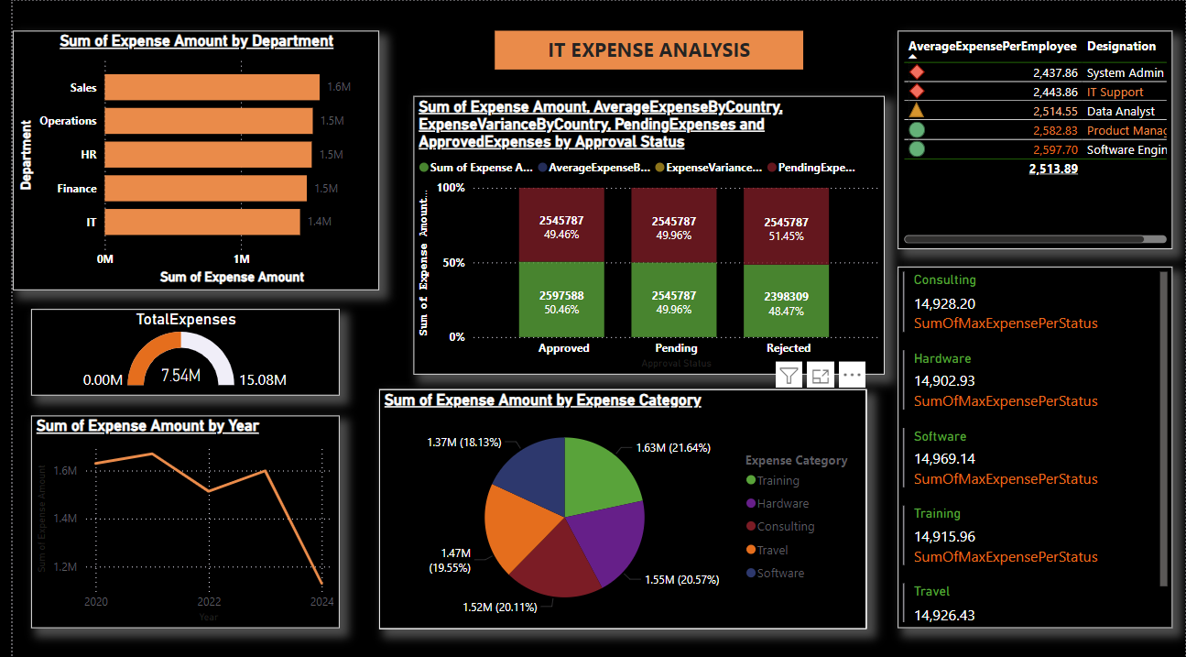
DASHBOARD
Page 1

Slide 6
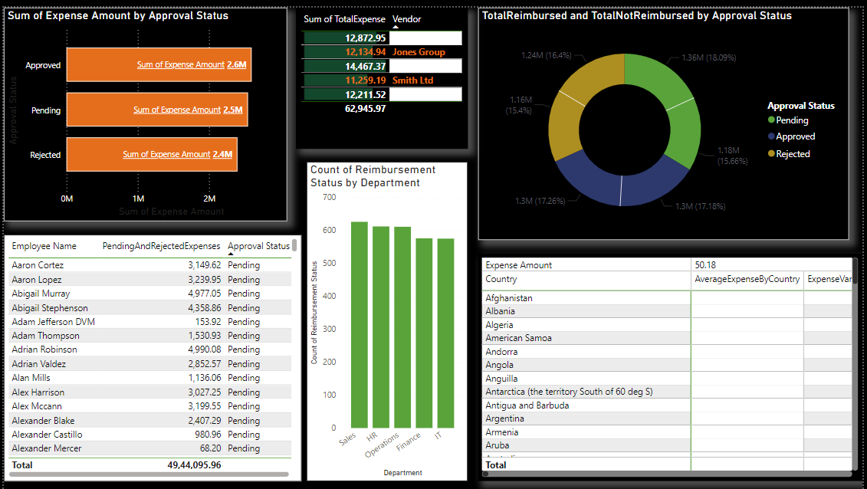
Page 2

Slide 7
CONCLUSION
Analyzing IT expenses using Power BI provides organizations with enhanced visibility into their spending patterns, revealing key areas where costs can be optimized. By leveraging attributes such as Expense Category, Vendor, Project Name, and Department, Power BI enables a holistic view of IT expenditures, helping to identify high-cost areas and uncover cost-saving opportunities. This streamlined approach improves budget management, enhances accountability, and supports proactive decision-making by automating reporting and providing real-time insights. Ultimately, Power BI empowers organizations to gain better control over IT expenses, optimize resource allocation, and support strategic financial planning, leading to improved overall financial health.

Slide 8
THANK YOU

